Slide 1

Welcome

Slide 2
Business Process Automation
Class – 01

Slide 3
What we will do today
Introduction to RPA
Introduction to UiPath
Installing UiPath
Creating our very First Project

Slide 4
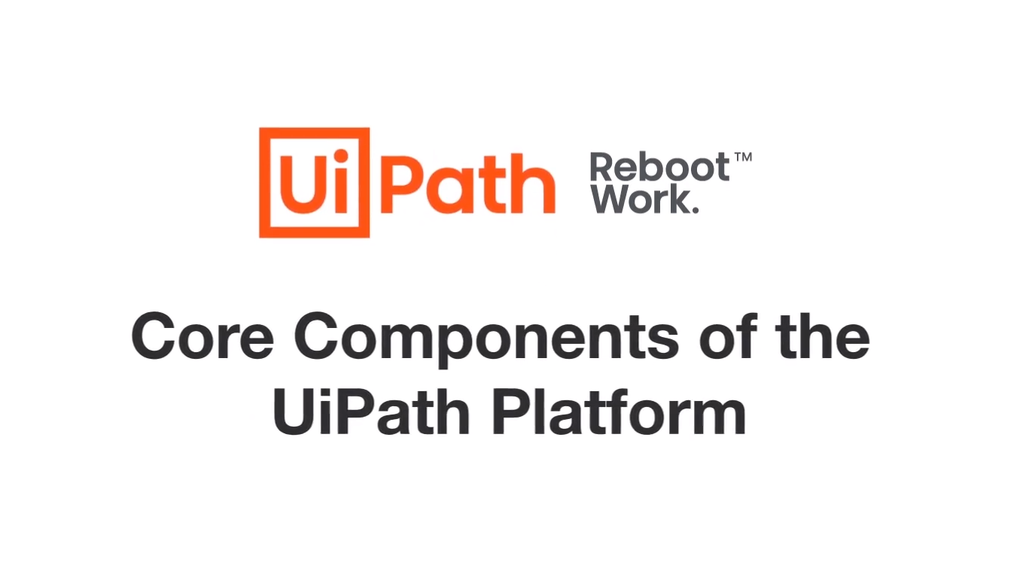

Slide 5
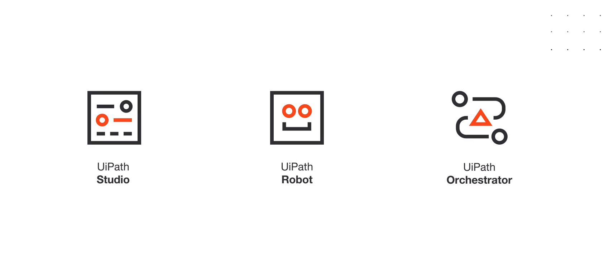

Slide 6
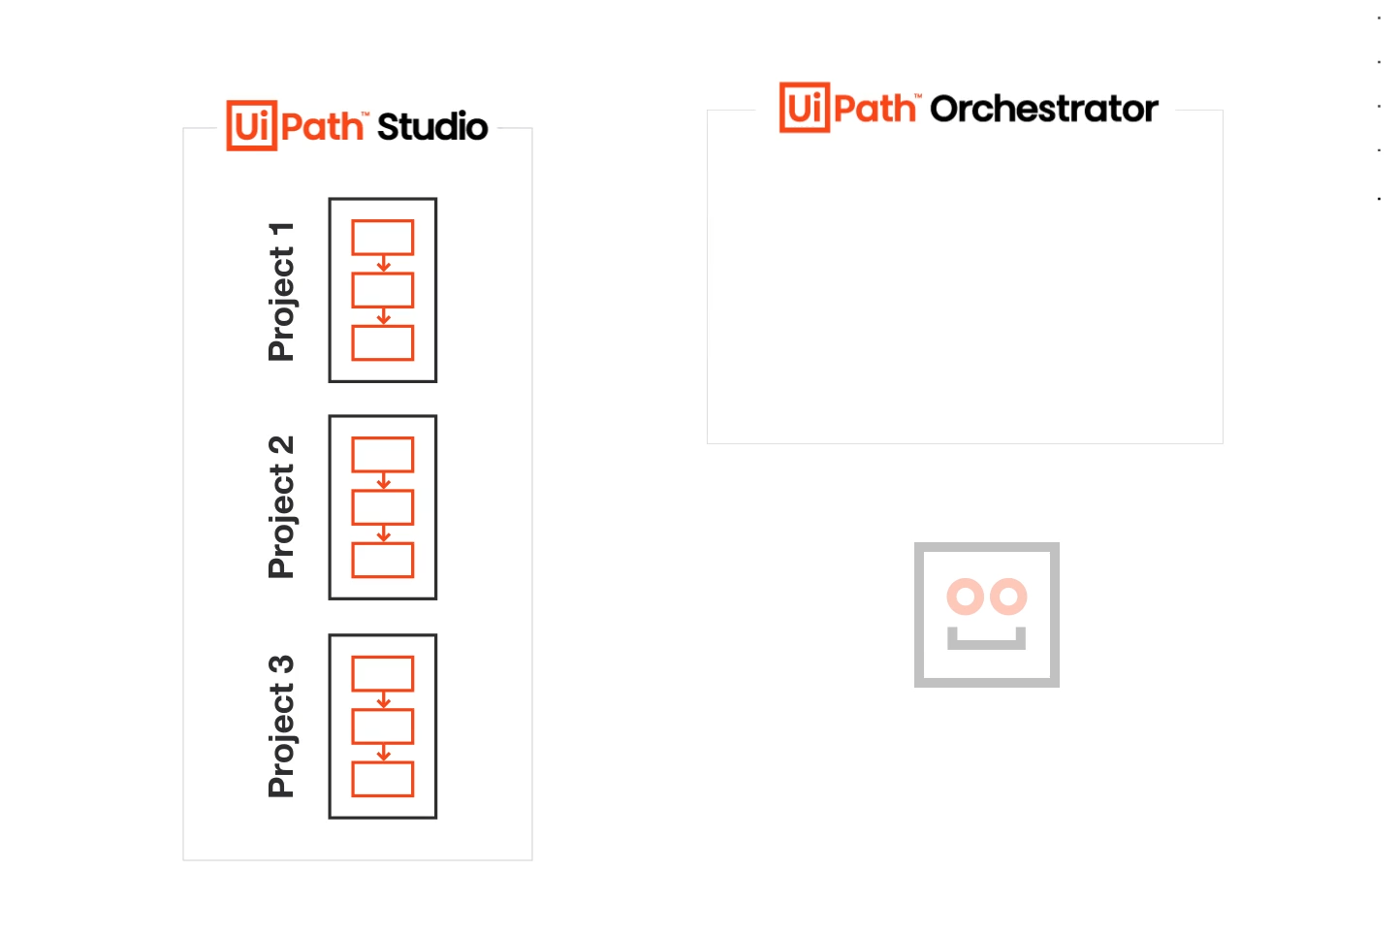

Slide 7
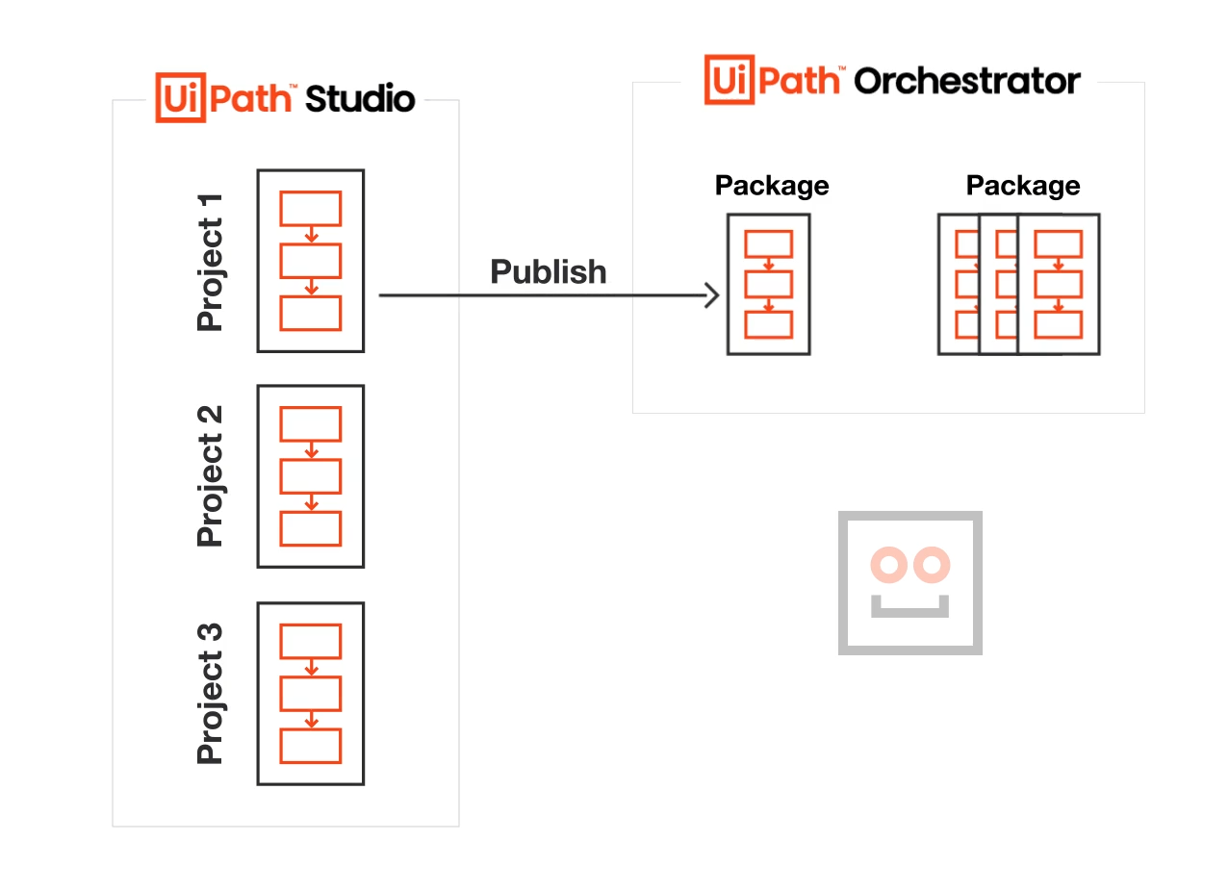

Slide 8
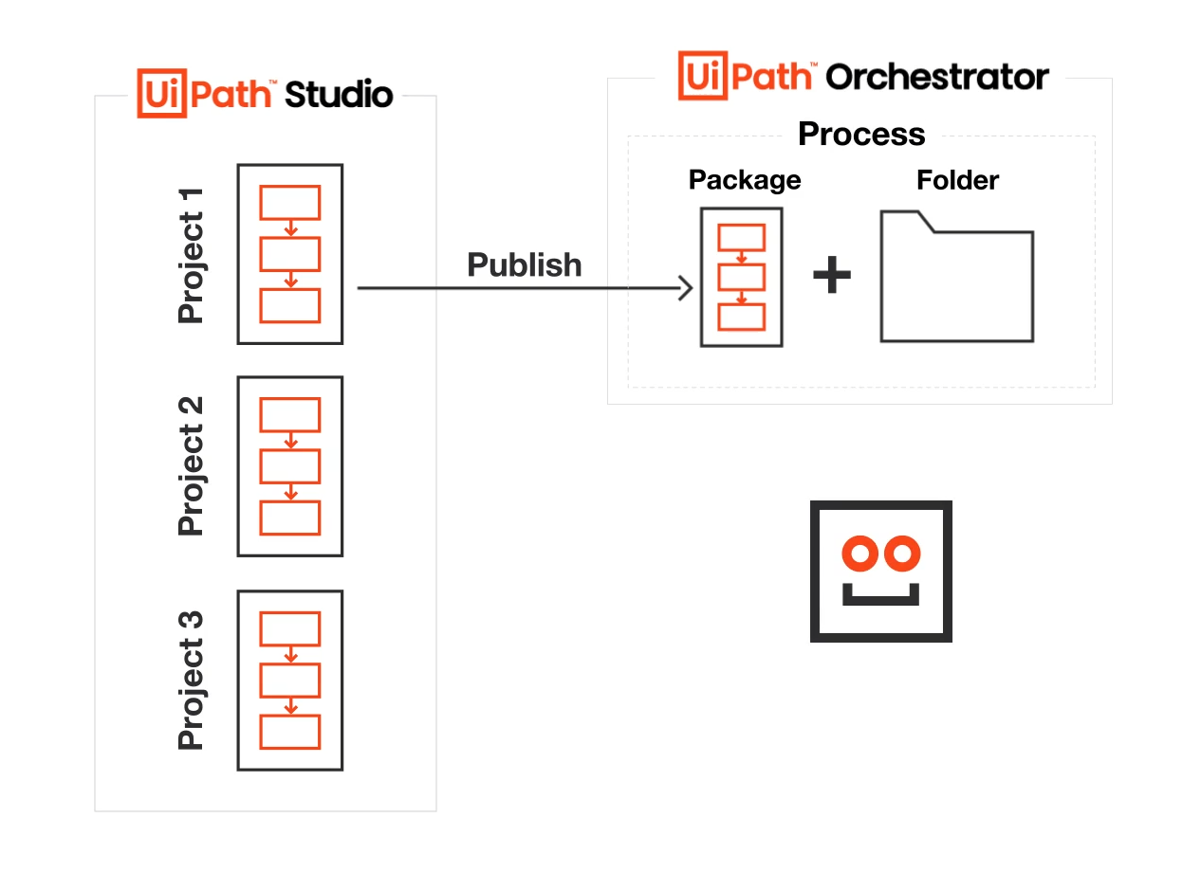

Slide 9
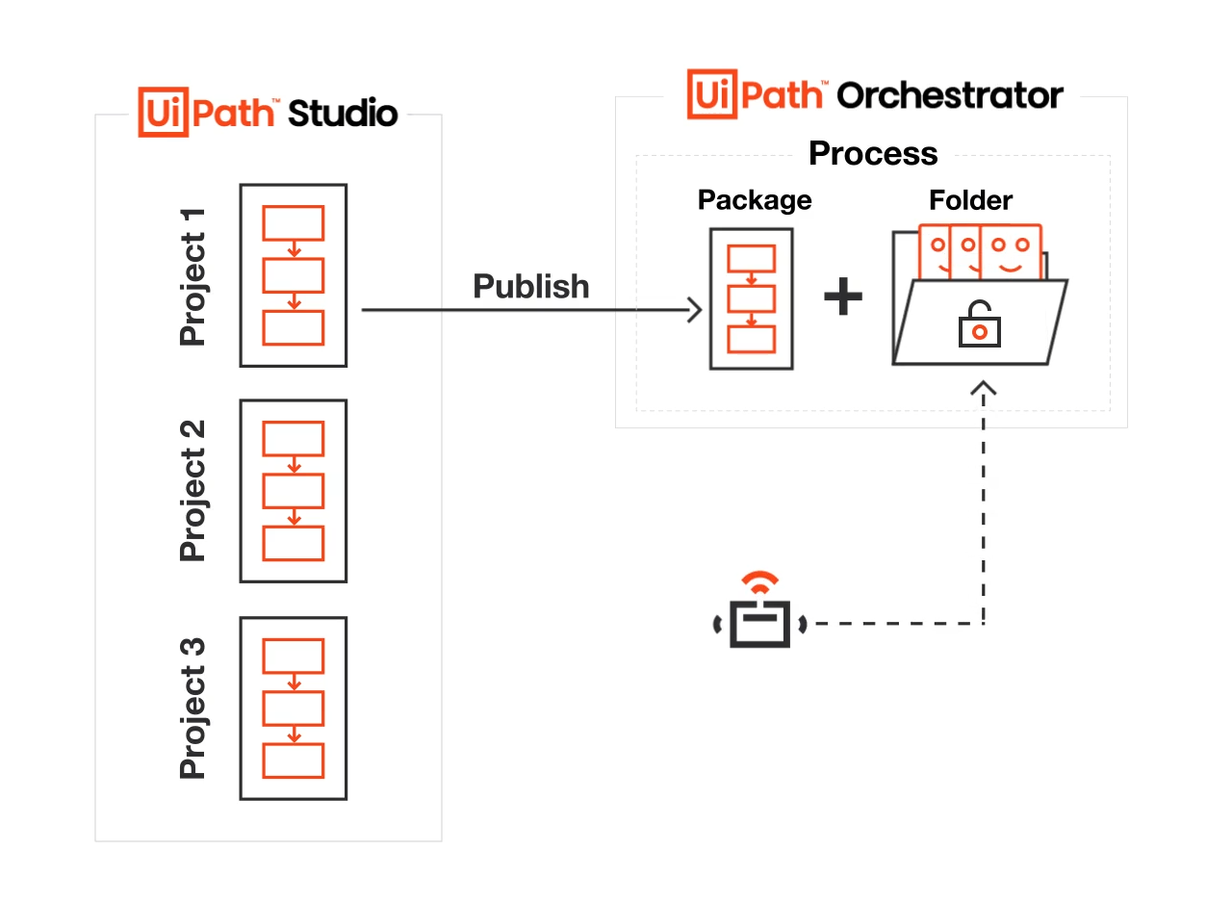

Slide 10
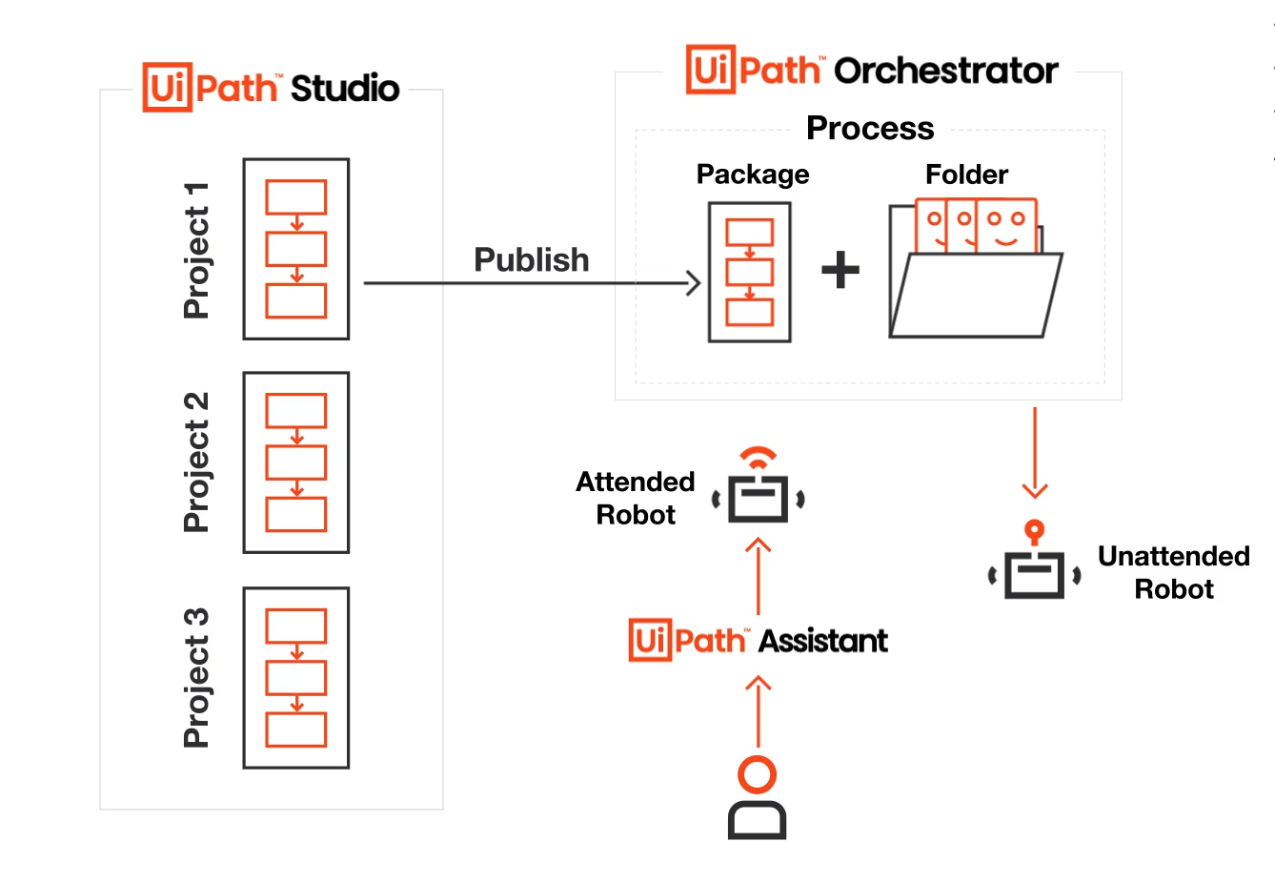

Slide 11
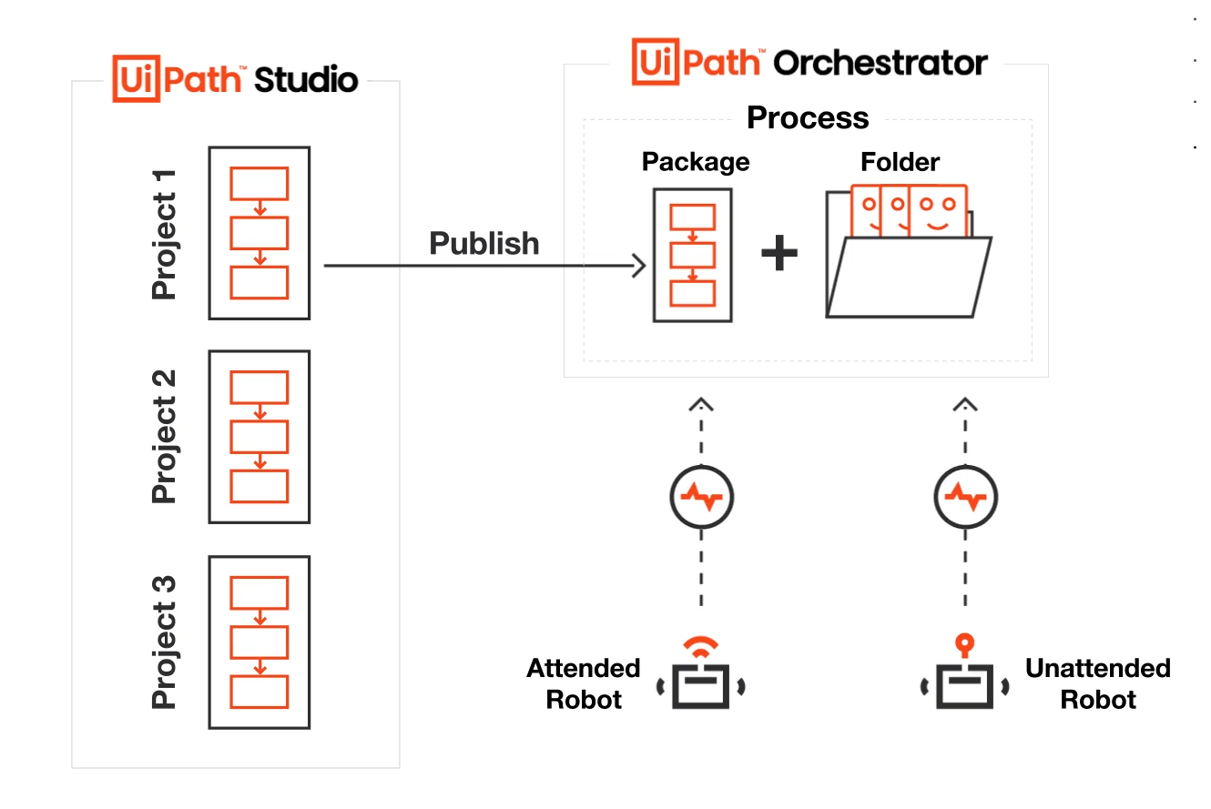

Slide 12
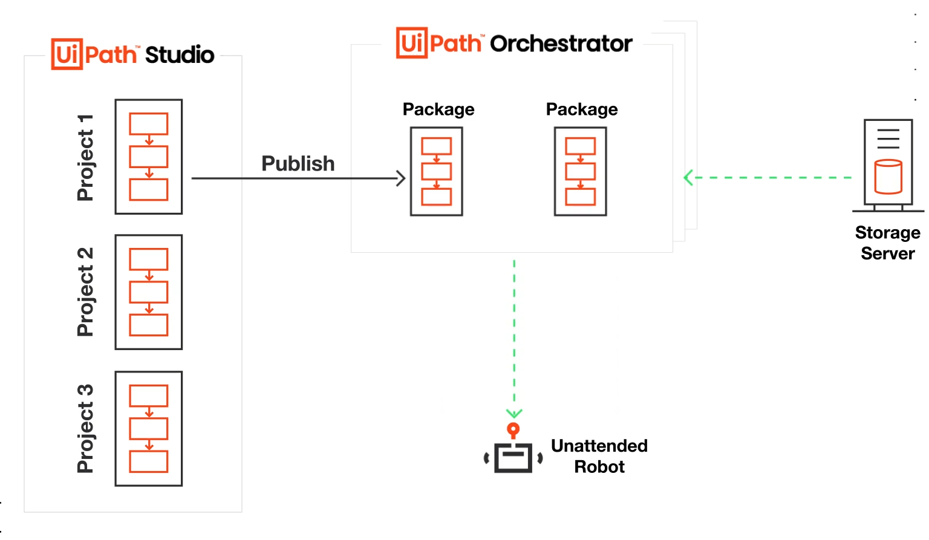

Slide 13
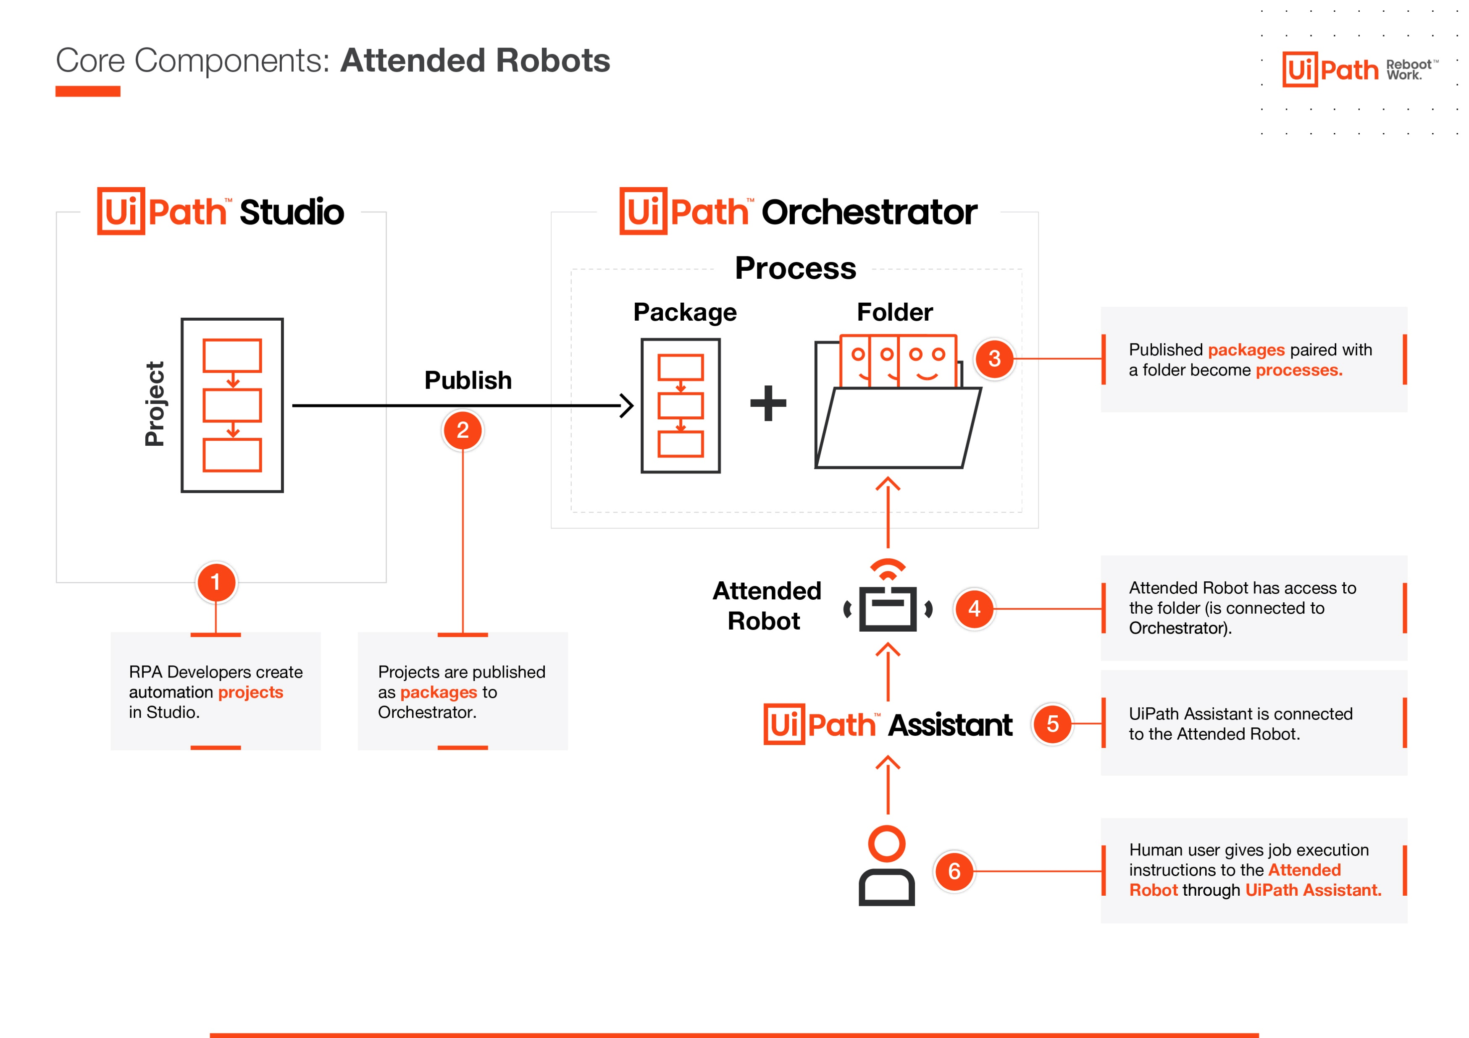

Slide 14
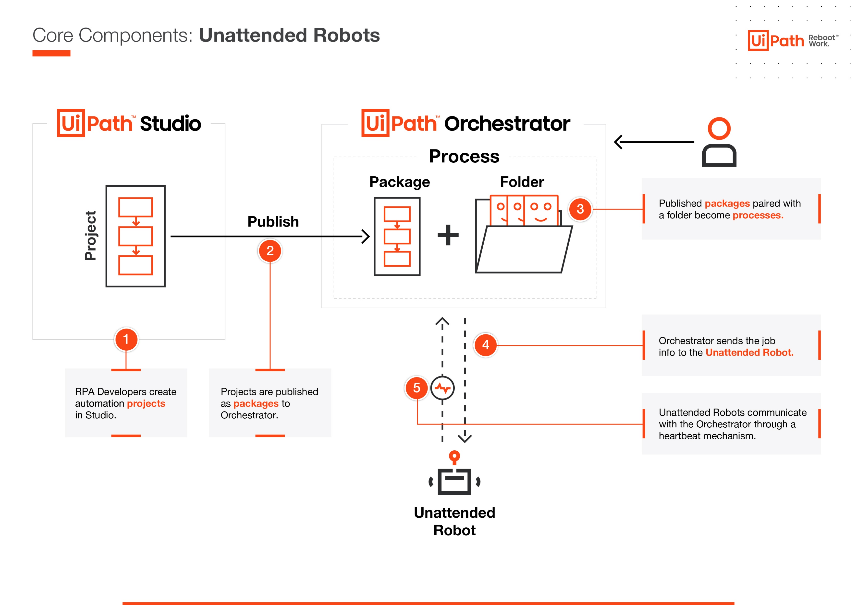

Slide 15
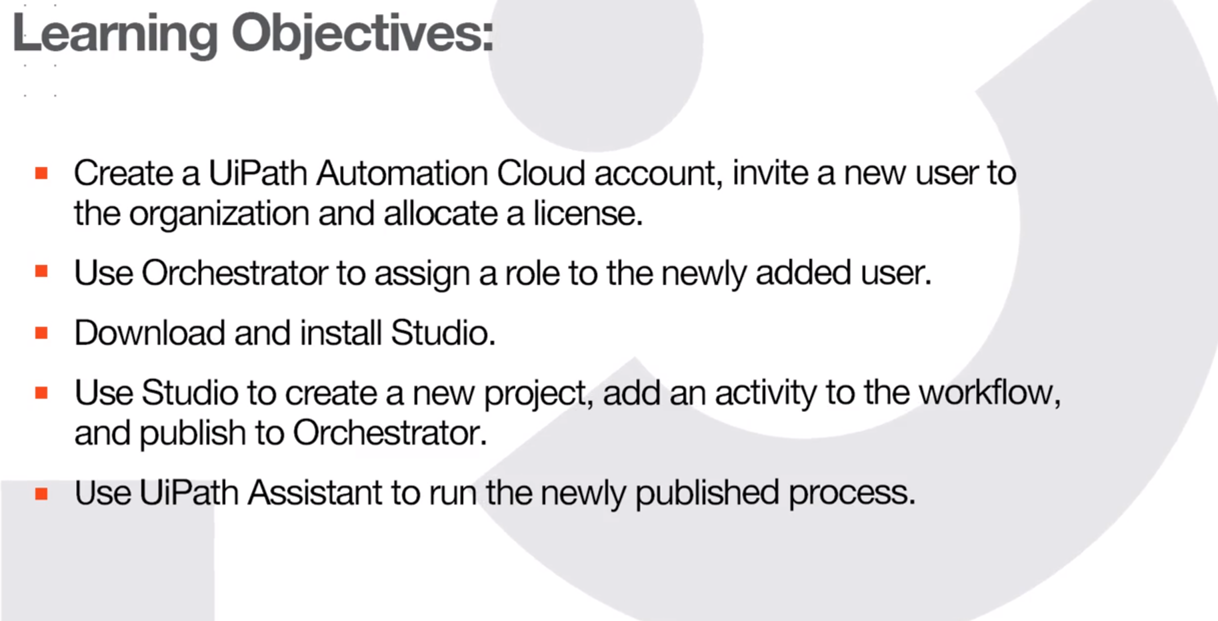

Slide 16
Hands on !!

Slide 17
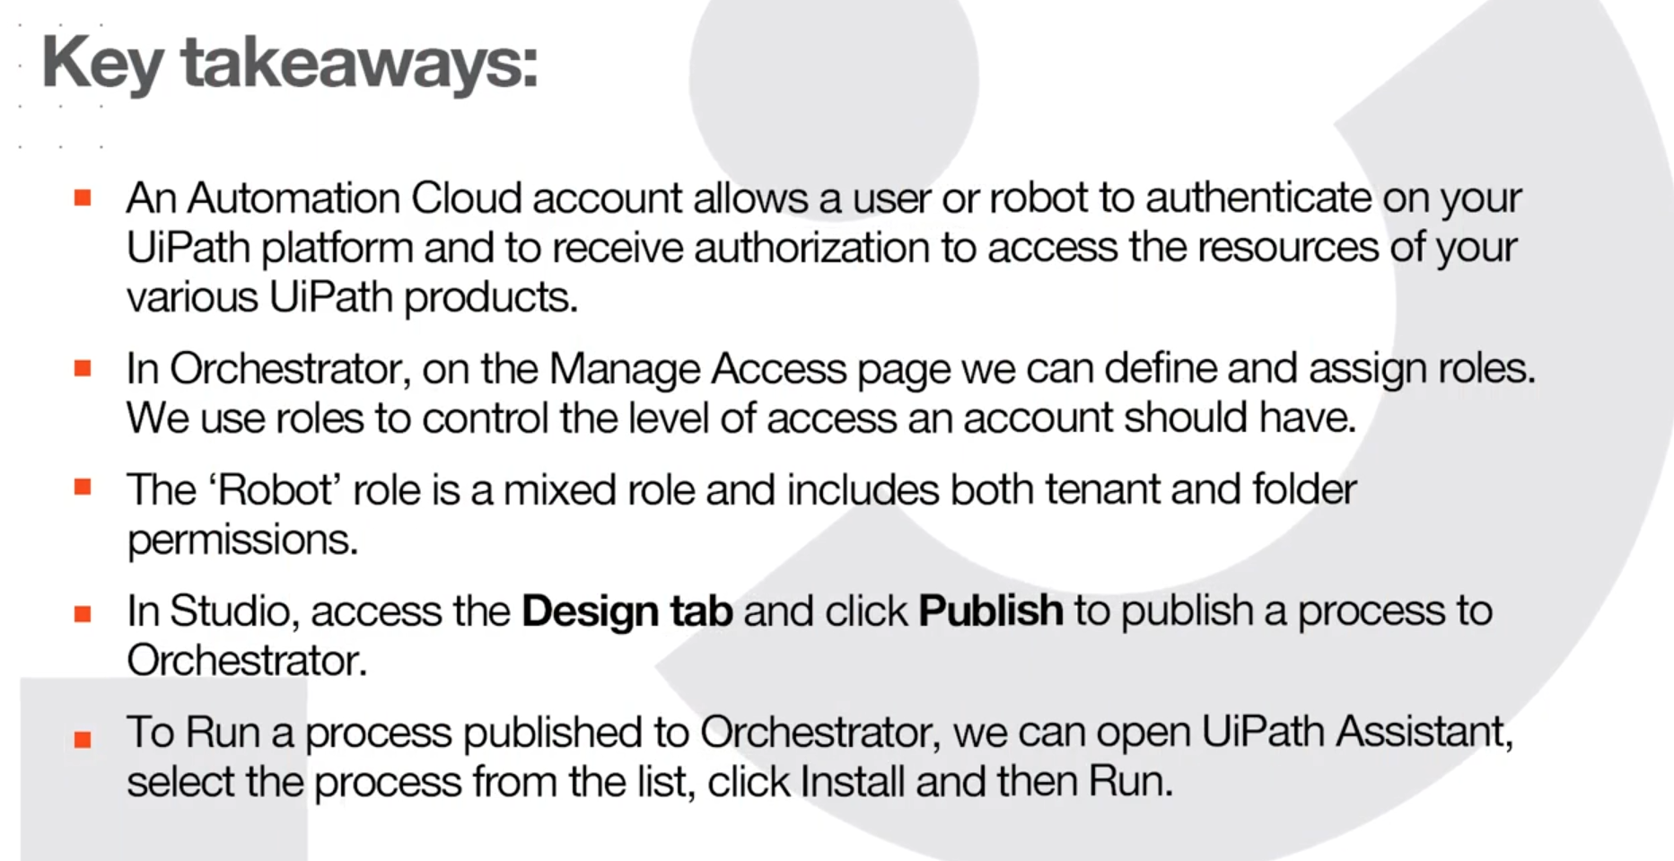

Slide 18
Key knowledge areas
One of the key goals of an RPA Developer is to efficiently build reliable processes according to business requirements. The journey to achieve this goal can be broken down into three steps:

Slide 19
Become an Associate RPA Developer - This stage means you are able to create effective processes or workflows to be integrated in larger projects by senior RPA Developers. To reach this stage, you can complete the RPA Developer Foundation learning plan, work on a few projects then pass the Associate Certification exam.
Become an Advanced RPA Developer - This stage means that you are able to create complex projects on your own using the Robotic Enterprise Framework. To reach this stage, you can complete the Advanced Learning Plan, implement a few projects then take the Advanced RPA Developer exam.
Become an Expert RPA Developer - There are several areas of specialization you can explore at this stage. Among them: AI Center, Document Understanding, Data Service, Orchestration Process and Action Center, Test Automation.

Slide 20
Business Process Automation
Class – 02

Slide 21
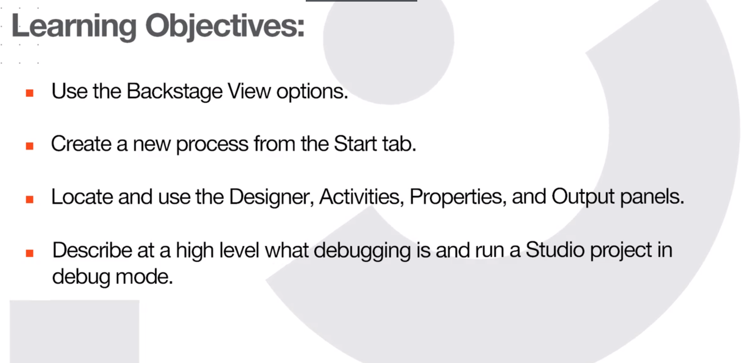

Slide 22
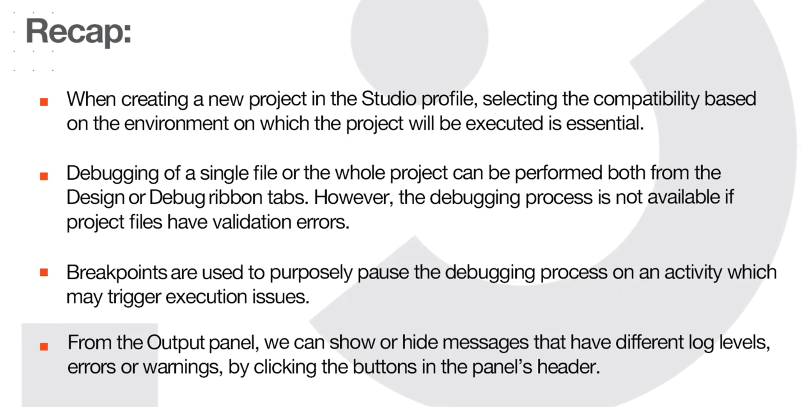

Slide 23
Understanding the Business Scenario
Our first step in workflow development is to understand the 'as-is'/current process and get the business' approval, before starting the development.
Usually, in an RPA project implementation, the Business Analyst is the one who captures all the 'as-is' and 'to-be' process steps and any other documented details from the Subject matter experts and the business team.
Afterwards, the process steps are thoroughly documented within the Process Definition Document (PDD) and validated with the Solution Architect.

Slide 24
Understanding the Business Scenario
The Project Manager performs the final step at this stage, getting the documented PDD signed-off by the business.
Depending on the context, you might not always have a Business Analyst or a Solution Architect working on the automation project. In this scenario, you'd be responsible for analyzing, documenting, and assessing the automation potential of the process steps.

Slide 25
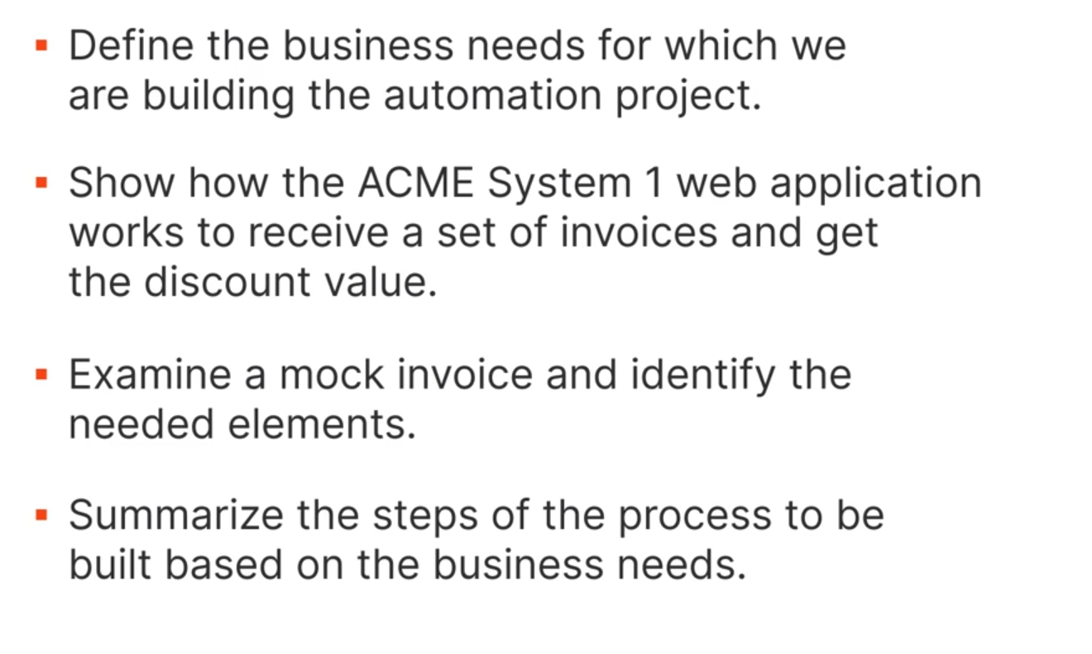
Let’s Automate

Slide 26
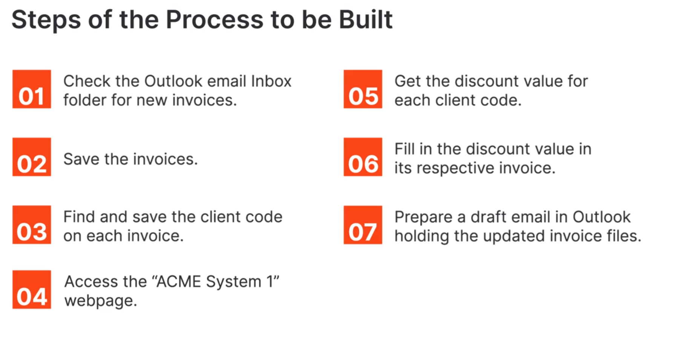

Slide 27
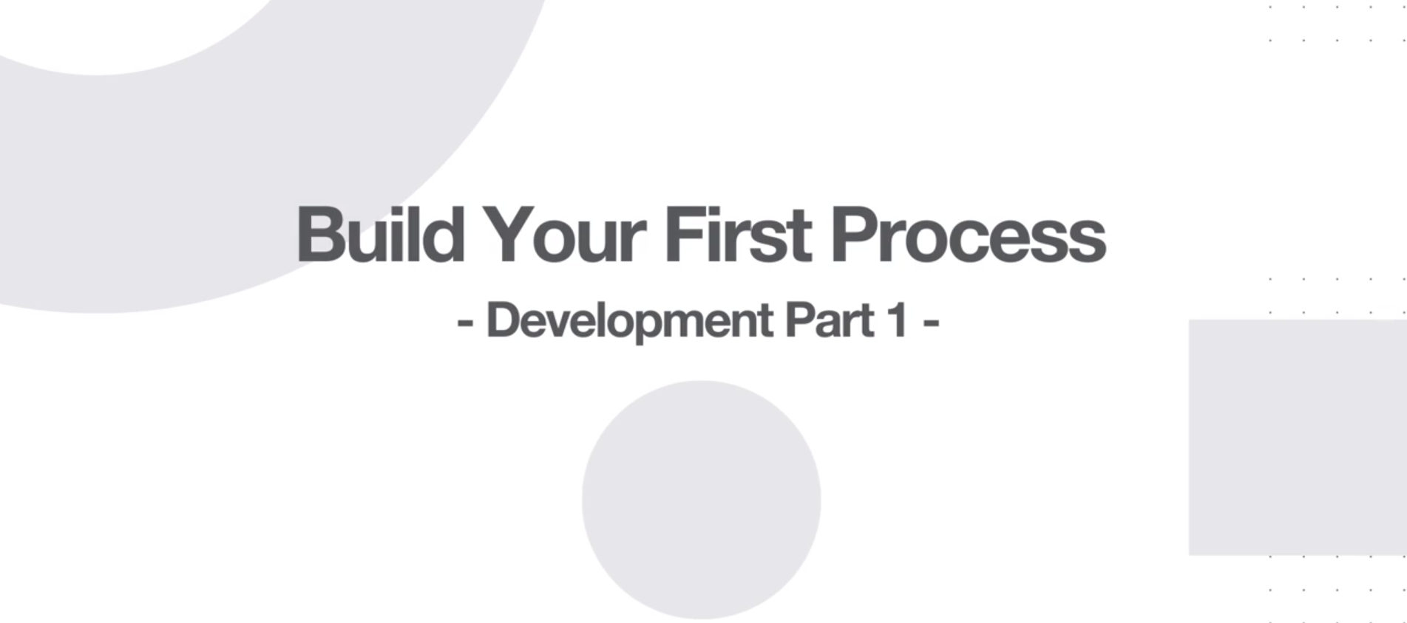

Slide 28
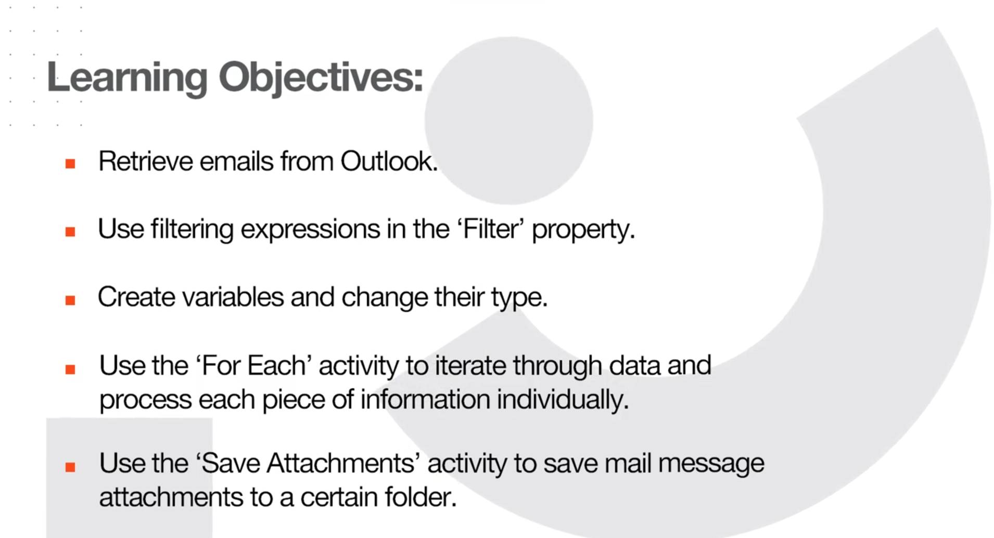

Slide 29
Hands on !!

Slide 30
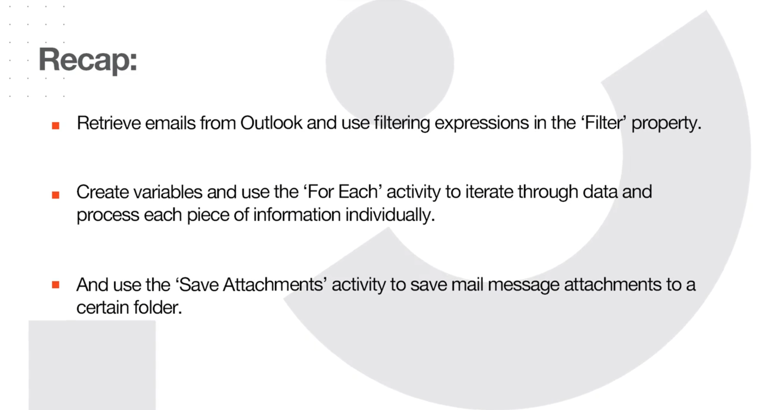

Slide 31
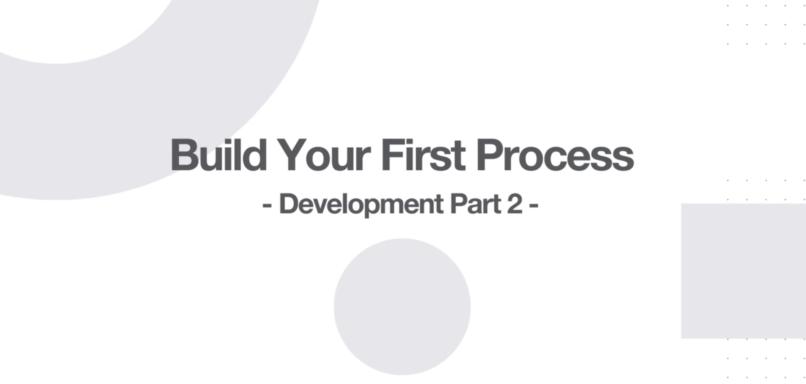

Slide 32
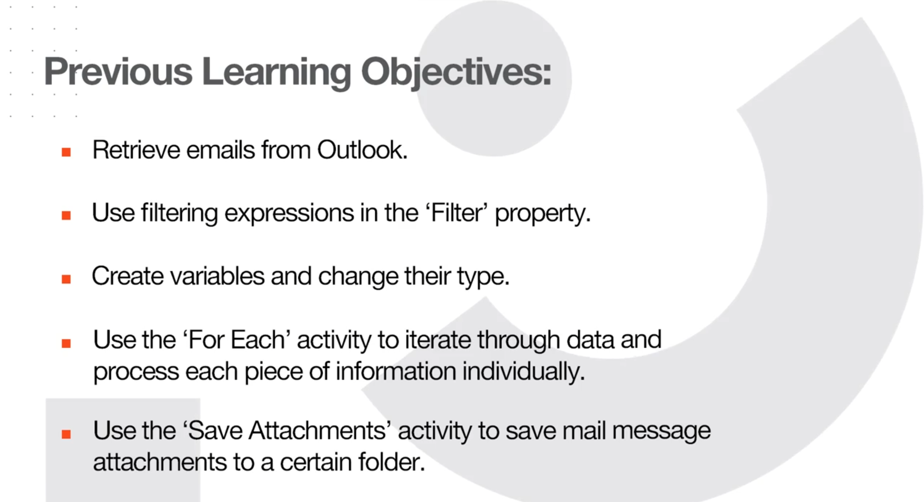

Slide 33
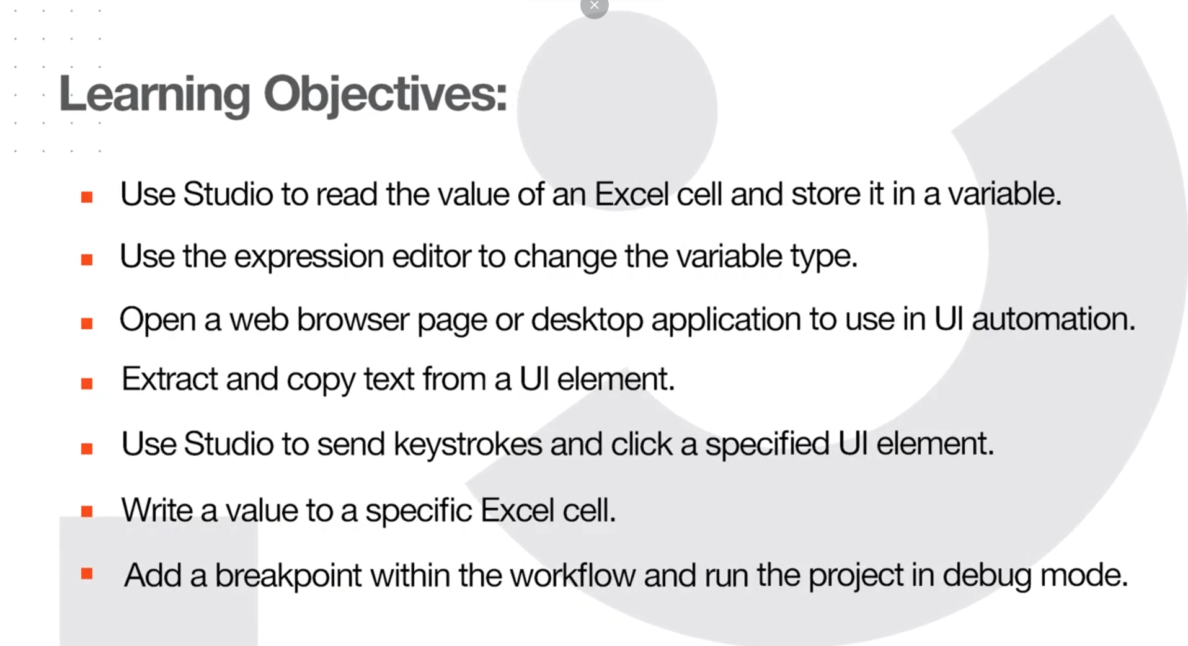

Slide 34
Hands on !!

Slide 35
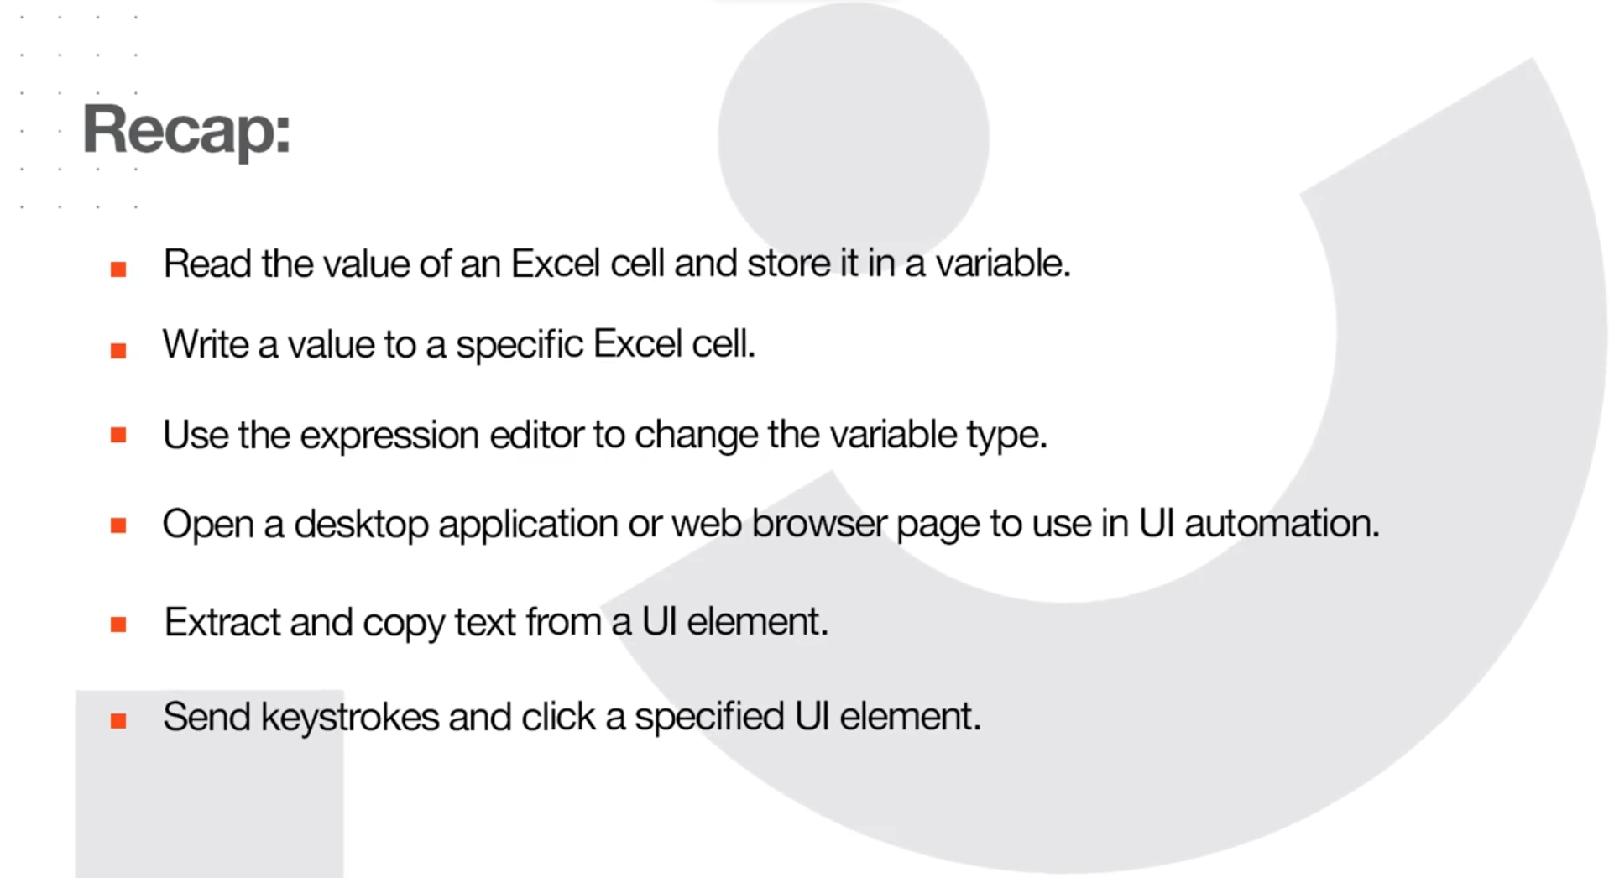

Slide 36
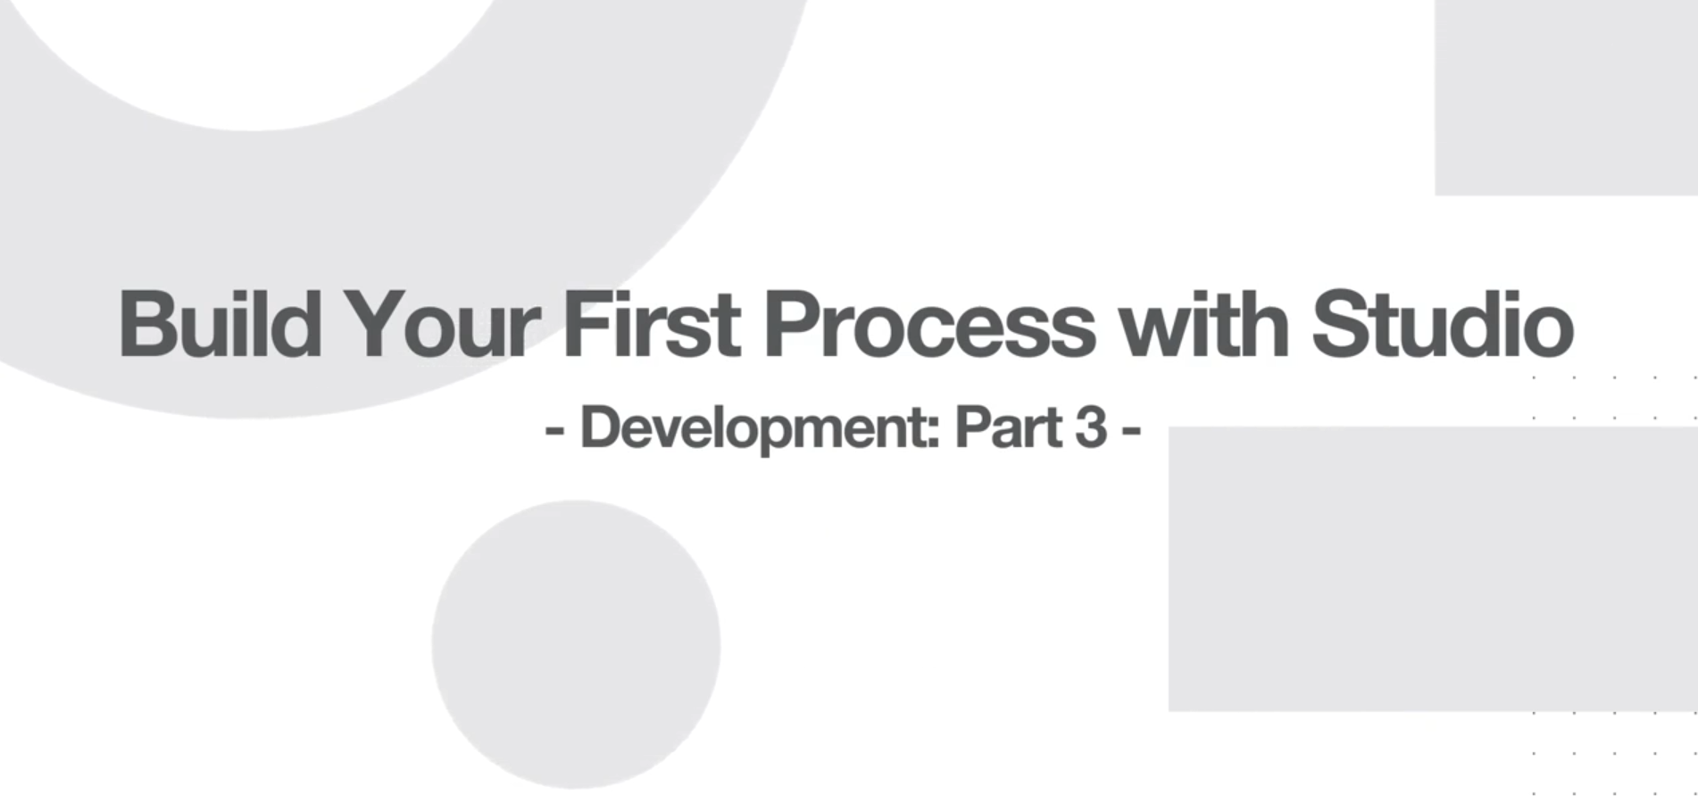

Slide 37
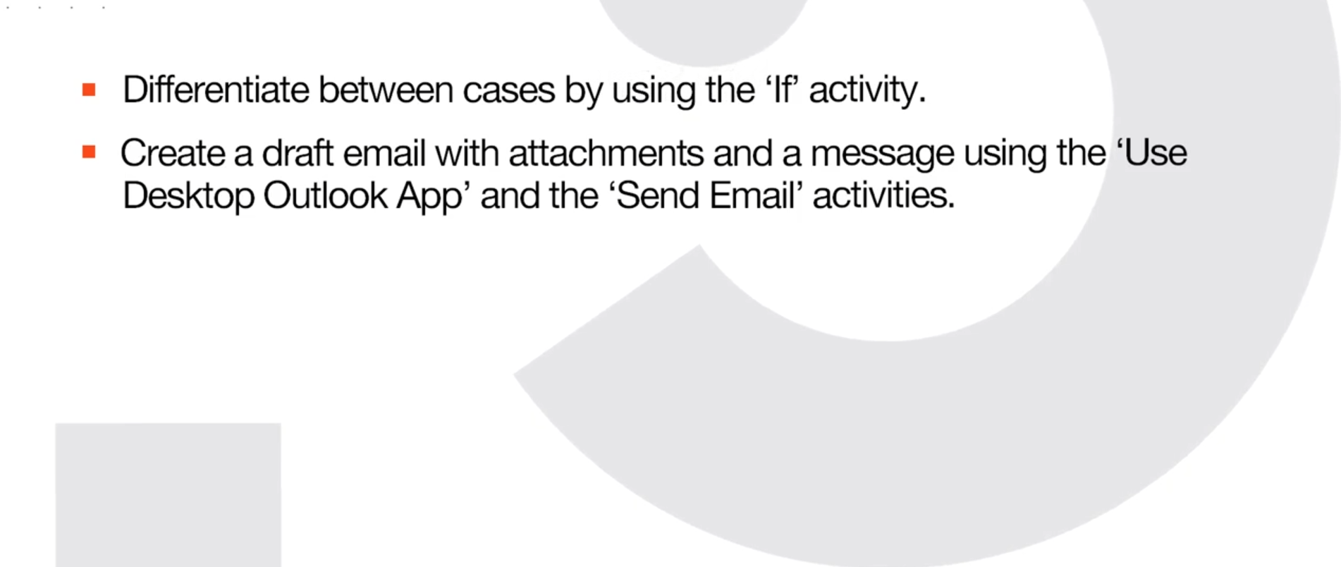

Slide 38
Hands on !!

Slide 39
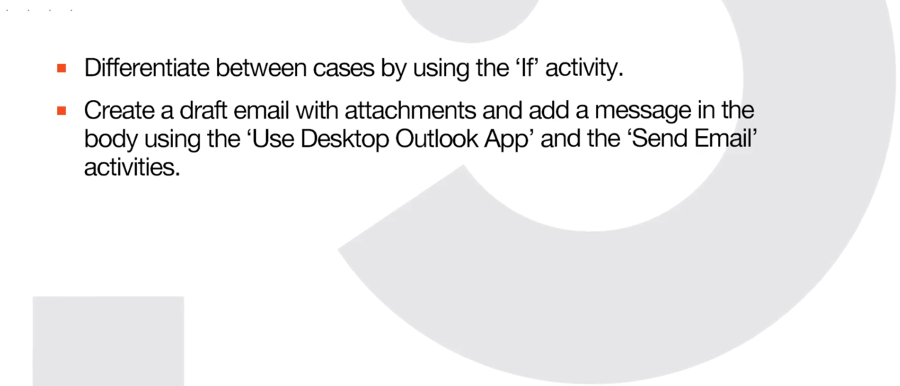

Slide 40
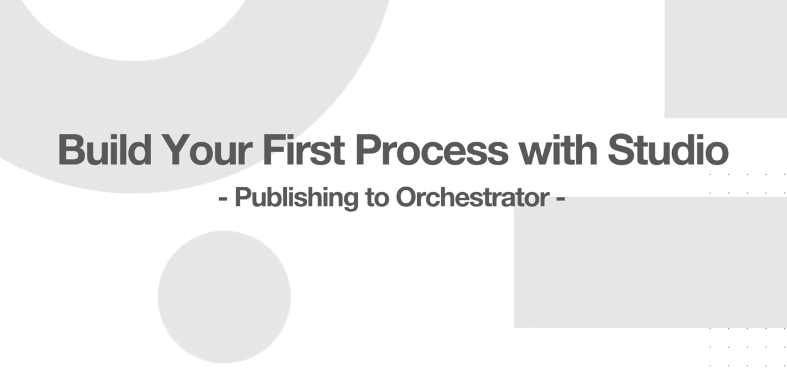

Slide 41
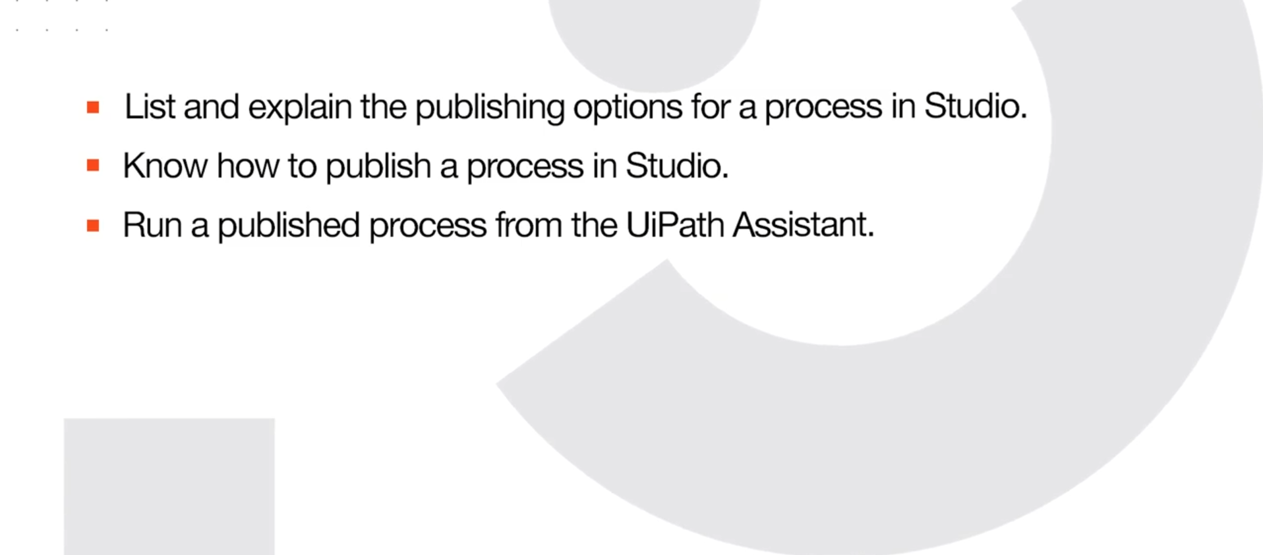

Slide 42
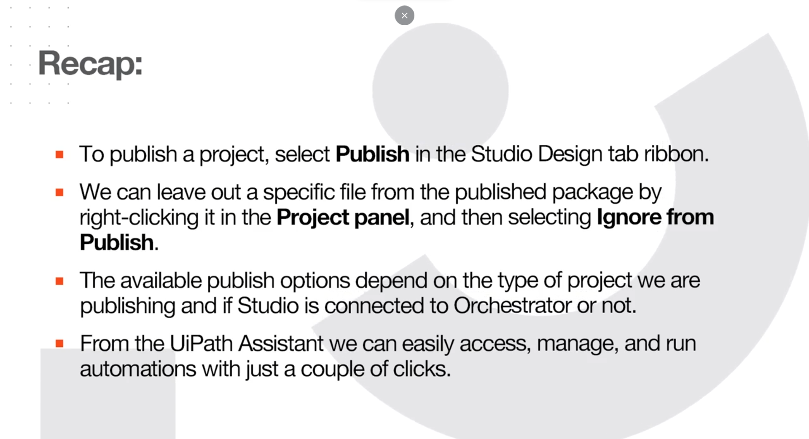

Slide 43

That’s it

Slide 44

Thanks

